Slide 1

Digital Technology
HTML Training
By Jason Sienkiewicz
and Afroditi Devrelis

Slide 2
What is HTML 5?
Hyper Text Markup Language (HTML)
HTML is one of the most widely used languages on Web to develop web pages

Slide 3
Download Notepad ++
This program is used to write and edit HTML code.
Click on the following link:
https://notepad-plus-plus.org/downloads/v7.8.1/

Slide 4
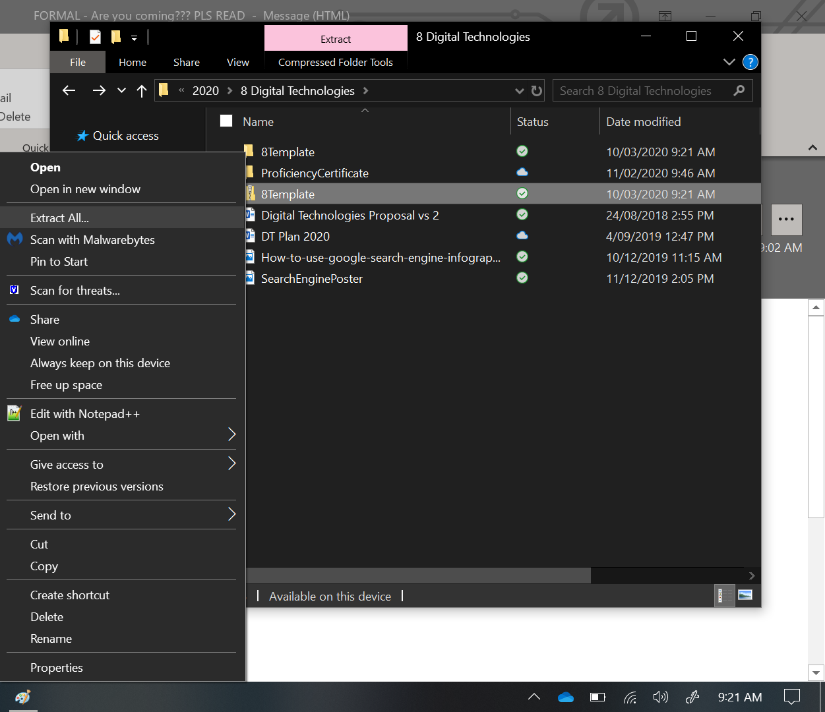
Unzip Folder 8Template
Right click on the 8Template.zip file, choose extract all

Slide 5
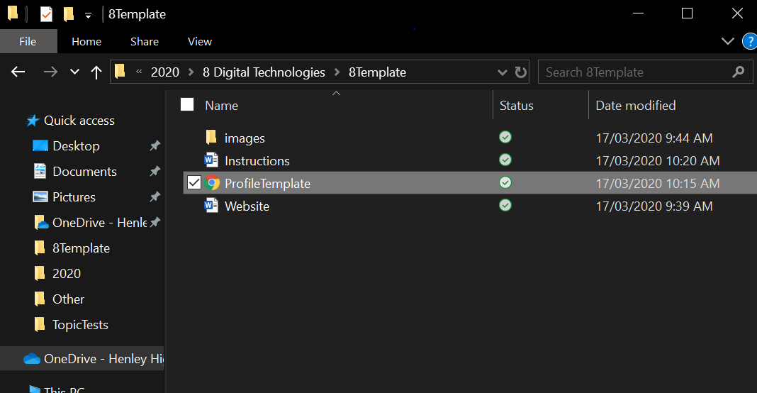
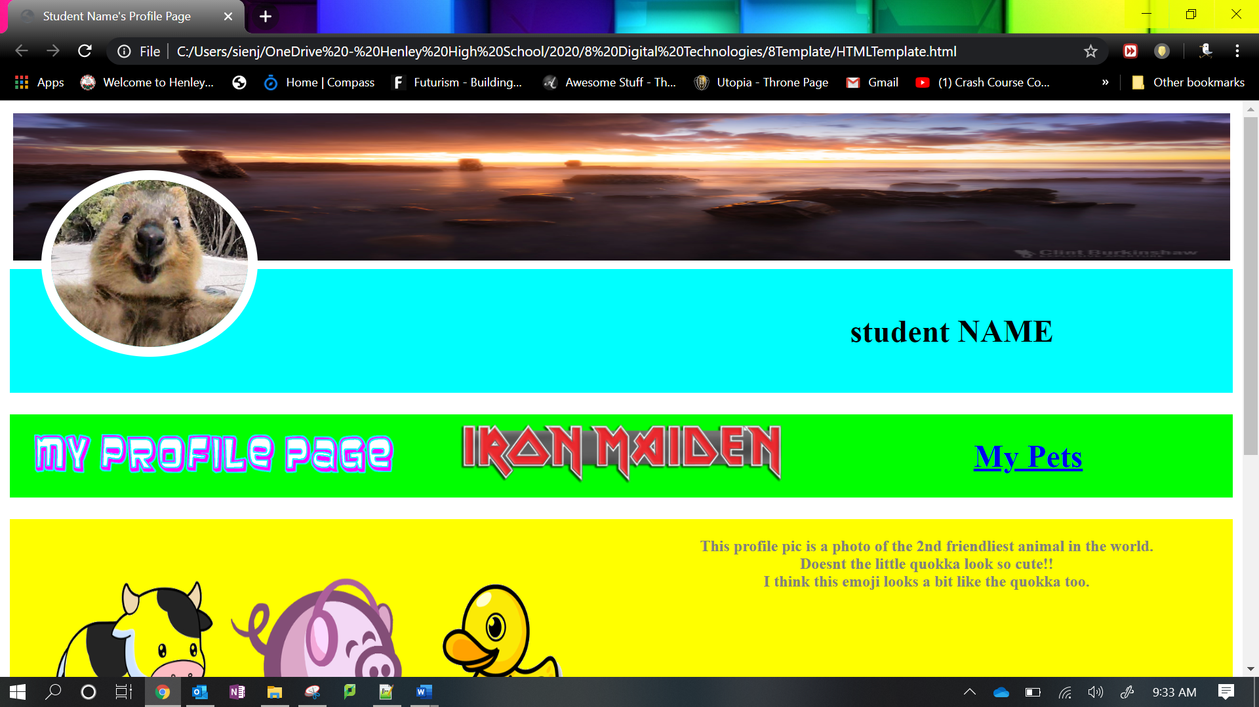
Run the Web Page
Go to the unzipped folder, “8Template”
Double click on the “ProfileTemplate” file

Slide 6
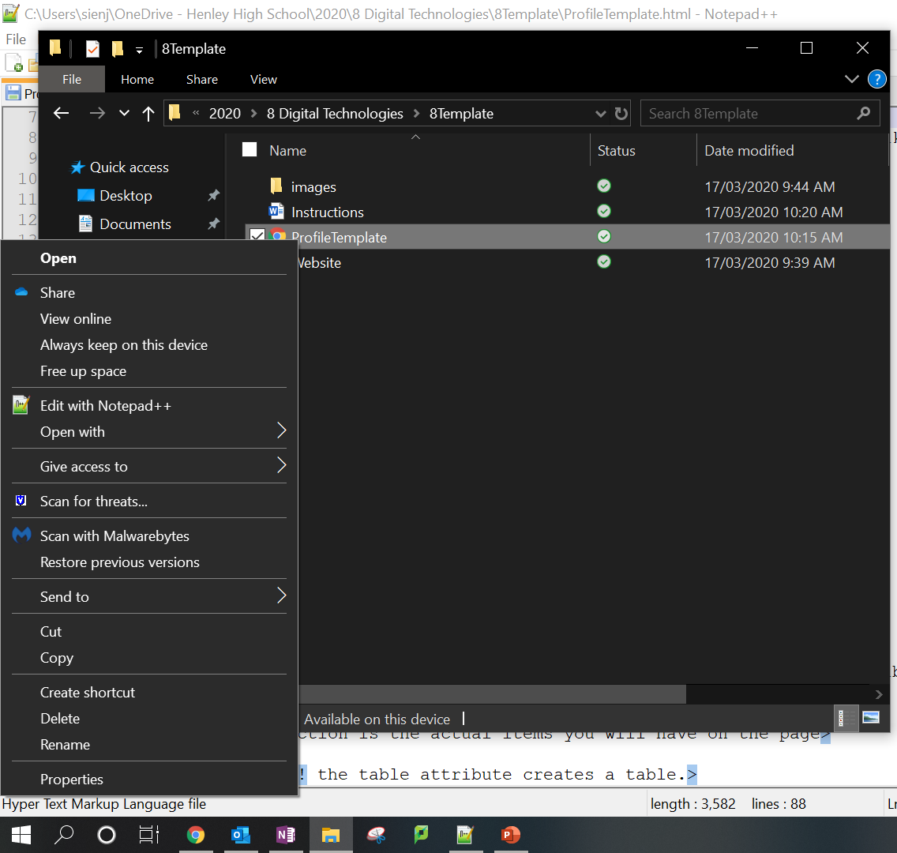
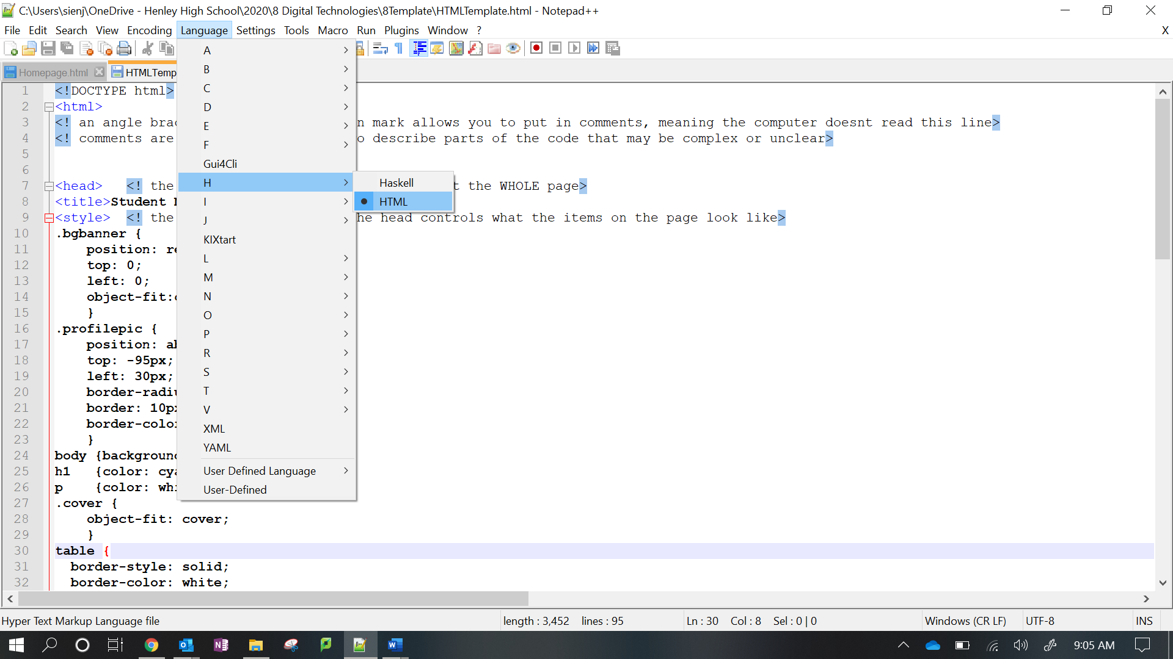
Open HTML Given Code
Go to the unzipped folder, “8Template”
Open the document “ProfileTemplate”, by:
Right clicking on HTMLTemplate, then click Edit With Notepad ++
When you are in Notepad ++, go to the Language menu and choose HTML

Slide 7
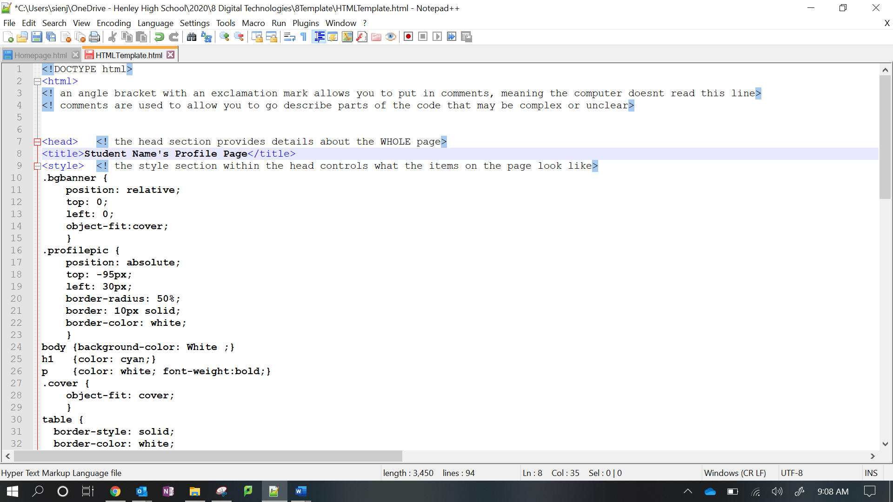
Manipulating the HTML 5 Given Code
Change the title by replacing the text with your name:
Save and refresh the page

Slide 8
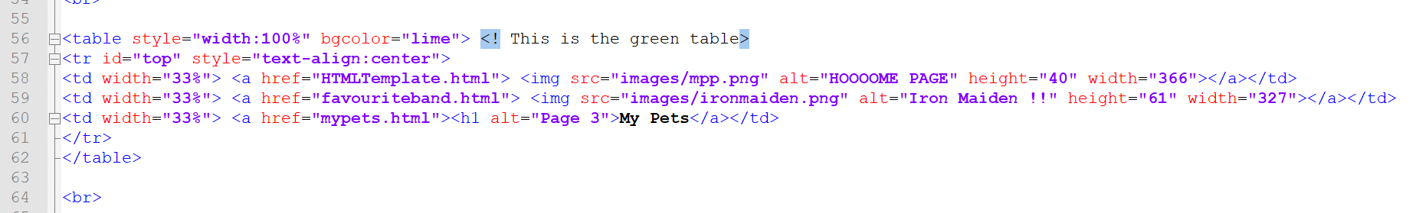
Creating a new Web Page
Go to the “8Template” file and create a copy.
Change the name to, “Favourite Band”
Edit the title of the web page as previously done
In Notepad ++ open the original HTML template, “ProfileTemplate”
Go to line 59, change the code favouriteband.html to your file name you just created
Save and refresh

Slide 9
Refresh to See Changes
Go to the original web page and single click on “Iron Maiden”
By doing this the title
changes

Slide 10
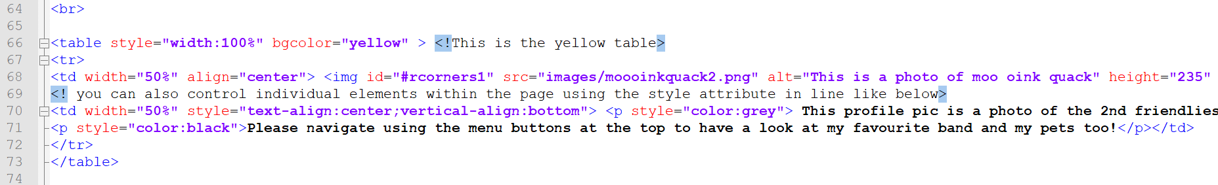
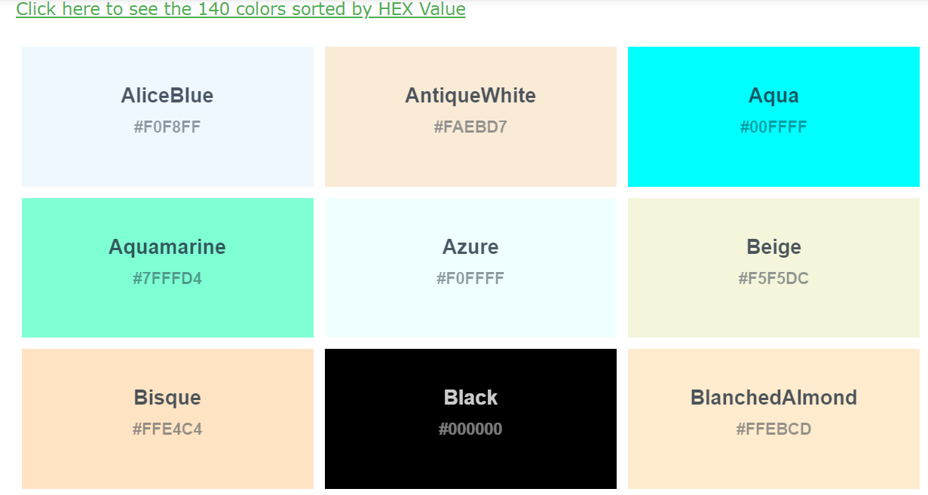
Colour Change
Go to the given HTML 5 code
Go to line 66 and change the word yellow to any colour you like (i.e. CornflowerBlue)
The following web page has a list of colour names one can use
https://www.w3schools.com/colors/colors_names.asp
Save and refresh

Slide 11
Image Change
Go to Google Images and find a logo of your favourite band and save it in the “images” folder. Choose an appropriate image name
Go to the given HTML 5 code
Go to line 59 and find the code:
src="images/ironmaiden.png”
Replace the code, “ironmaiden.png”, with your logo filename.
Ensure your file type in correct (e.g. png, jpg, jpeg, bmp etc)
Save and refresh

Slide 12

Any Questions

